Slide 1
Big Data Management and Analytics
Apache Spark Streaming Setup
Notes:
<number>

Slide 2
Spark Streaming Example
In this example, we want to count the number of words in text data received from a Kafka producer.
First, we import “StreamingContext”, which is the main entry point for all streaming functionality.
We create a local StreamingContext with two execution threads, and batch interval of 1 second.
Notes:
<number>

Slide 3
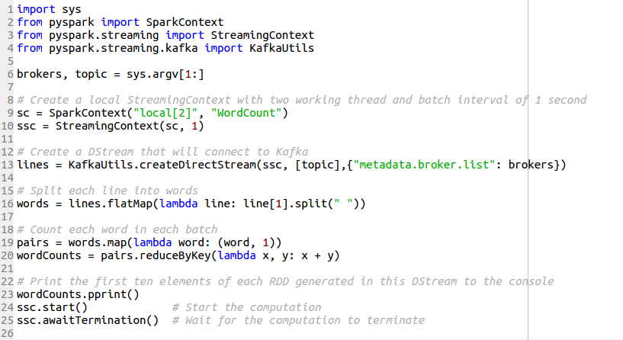
Spark Streaming Example
Notes:
<number>

Slide 4
Kakfa Setup
Operating system: Unix-based (although it also works on Windows platform, these instructions are for unix-based systems)
Step 1: Download the code and un-tar it:
https://www.apache.org/dyn/closer.cgi?path=/kafka/2.1.0/kafka_2.11-2.1.0.tgz
Ref: https://kafka.apache.org/quickstart
Notes:
https://spark.apache.org/docs/2.2.0/streaming-kafka-0-8-integration.html

Slide 5
Kakfa Setup (Cont’d)
Step 2: Start the ZooKeeper Server
If you do not have a ZooKeeper server on your system, you can use a single-node Zookeeper instance in the Kafka package.
$kafka-path> bin/zookeeper-server-start.sh config/zookeeper.properties
When it starts successfully, you will see:
[2013-04-22 15:01:37,495] INFO Reading configuration from: config/zookeeper.properties (org.apache.zookeeper.server.quorum.QuorumPeerConfig)
...

Slide 6
Kakfa Setup (Cont’d)
Step 3: Start the Kafka Server
$kafka-path> bin/kafka-server-start.sh config/server.properties
When it starts successfully, you will see:
[2013-04-22 15:01:47,028] INFO Verifying properties (kafka.utils.VerifiableProperties)
[2013-04-22 15:01:47,051] INFO Property socket.send.buffer.bytes is overridden to 1048576 (kafka.utils.VerifiableProperties)
...

Slide 7
Kakfa Setup (Cont’d)
Step 4: Create a topic
To create a topic named “test” with a single partition and one replica:
$kafka-path> bin/kafka-topics.sh --create --zookeeper localhost:2181 --replication-factor 1 --partitions 1 --topic test
If you run the following command, you will see the topic name:
$kafka-path> bin/kafka-topics.sh --list --zookeeper localhost:2181
test

Slide 8
Kakfa Setup (Cont’d)
Step 5: Send some messages by producer:
By using the following command, you can send messages to the server through the producer:
$kafka-path> bin/kafka-console-producer.sh --broker-list localhost:9092 --topic test
hello world hello Spark hello world

Slide 9
Kakfa Setup (Cont’d)
Step 6: Receive the messages by consumer:
Kafka also has a command line consumer that will dump out messages to standard output:
$kafka-path> bin/kafka-console-consumer.sh --bootstrap-server localhost:9092 --topic test --from-beginning
hello world hello Spark hello world

Slide 10
Spark Streaming Example (Cont’d)
To run this example, we need to use the following command in a terminal:
Using --packages spark-streaming-Kafka-0-8_2.11 and its dependencies can be directly added to spark-submit, for Python applications.
$Spark-path> bin/spark-submit --packages org.apache.spark:spark-streaming-kafka-0-8_2.11:2.0.1 /path/to/code/streamwordCount.py localhost:9092 test
This is the name of topic that we created in the Apache Kafka.
Notes:
in your terminal by typing hostname you can have a look at your current hostname.
vim /etc/hosts and set the hostname you get just now to your exact ip or 127.0.0.1.
<number>

Slide 11
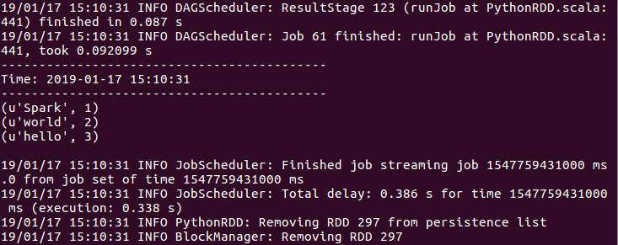
Spark Streaming Example (Cont’d)
The result will be shown in the running Spark terminal:
Notes:
<number>

Slide 12
References
Spark Streaming Guide:
https://spark.apache.org/
https://docs.databricks.com/spark/
https://www.simplilearn.com/spark-streaming-tutorial-video

